Slide 1

Weather
Monitoring
System
Kavya R (20BIS020)
Mega S S (20BIS024)
Priyadharshini S (20BIS033)

Slide 2
The system proposed is an advanced solution for weather monitoring that uses AWS IoT to make its real time data easily accessible over a very wide range.
When objects like an environment furnished with sensor devices, microcontrollers, and different software applications become a self-monitoring and self-protecting environment, it is called a smart environment.
The system uses sensors to monitor environmental parameters such as temperature and relative humidity.
Then, it sends the data to a web page.
The data updated from this system can be accessed on the internet from anywhere in the world. The embedded system enables the user to access the various criteria and store the data in the cloud.
IOT SYSTEM
FOR WEATHER MONITORING

Slide 3
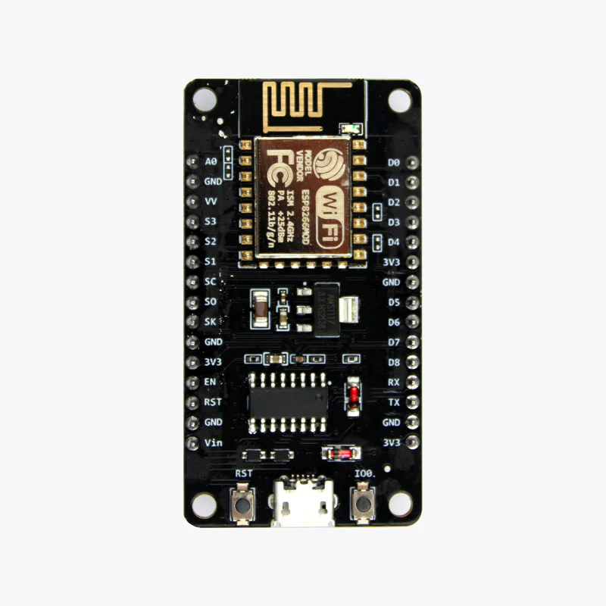

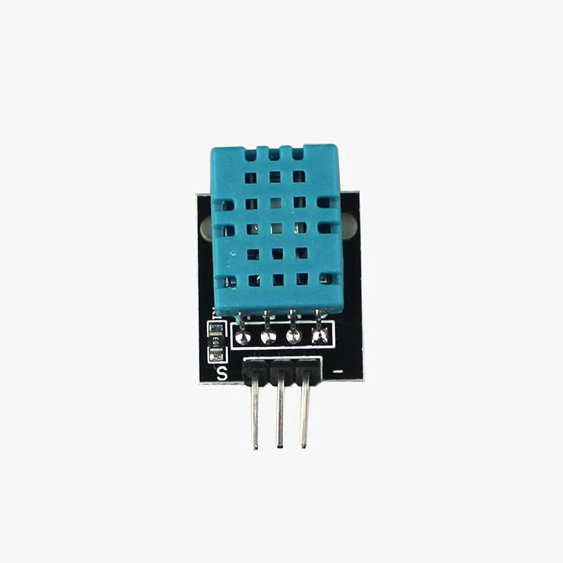

COMPONENTS
ESP8266
AWS IoT Core
DHT11 Sensor
Arduino IDE

Slide 4
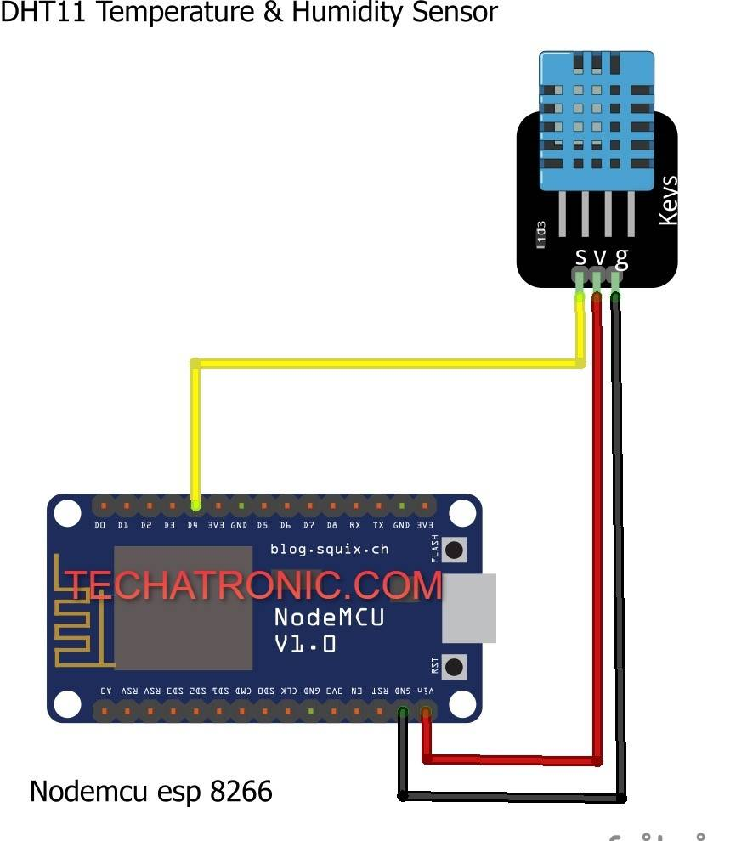
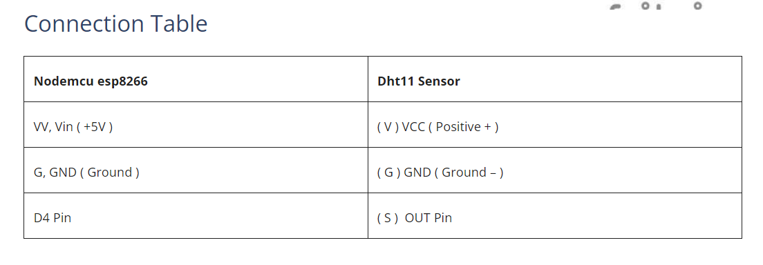
CIRCUIT DIAGRAM

Slide 5
Signing up & setting the Amazon Web Services
Installing Necessary Libraries to Arduino IDE & Writing an Arduino Sketch for the project
Creating a Thing is AWS
Creating Policy and attaching to Thing
Generating Certificates
Modifying Arduino Sketch according to Thing Data & Credentials
Subscribe & Publish Data to and from AWS Dashboard
STEPS INVOLVED

Slide 6
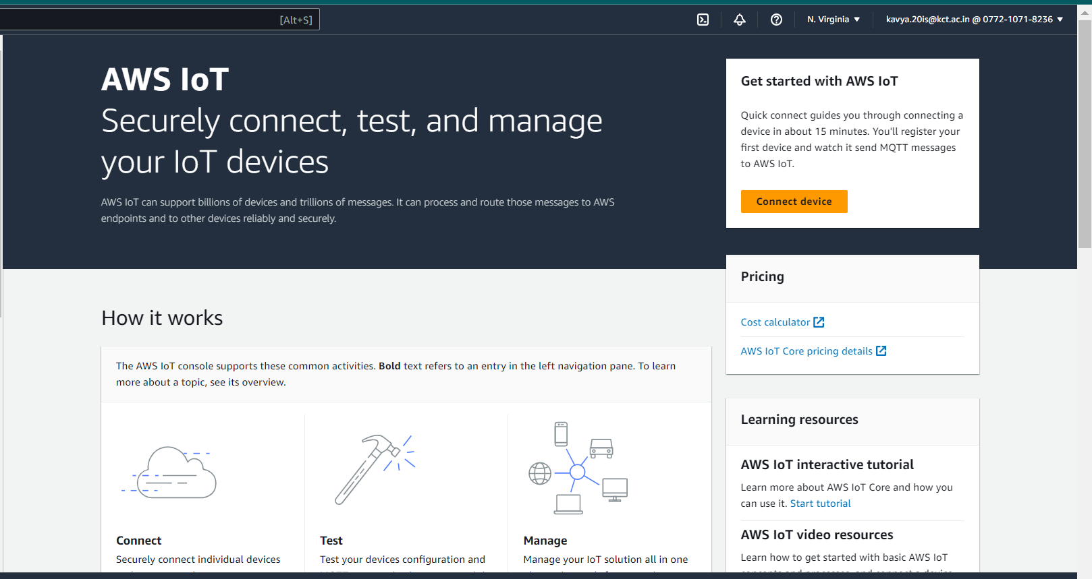
Sign in and set-up AWS IoT Core

Slide 7
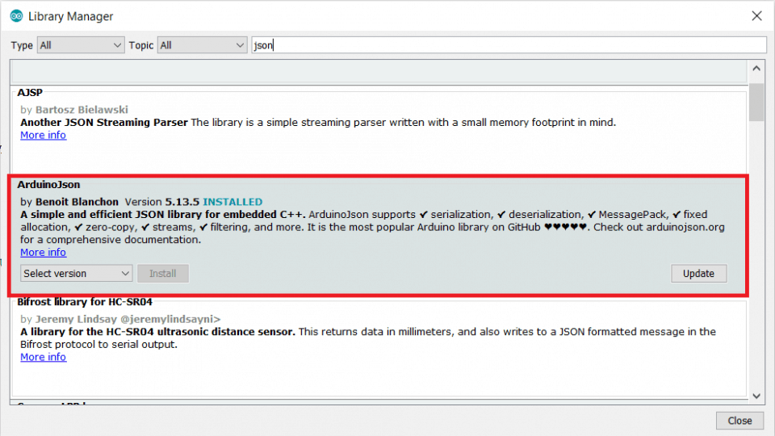
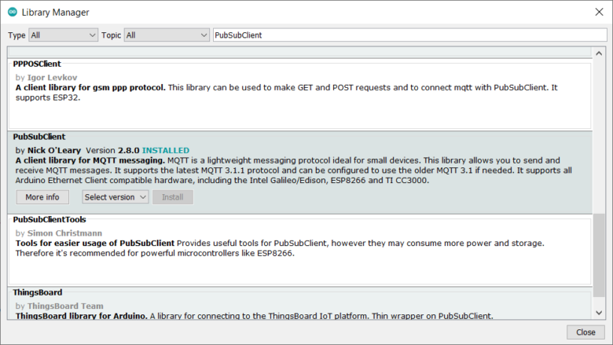
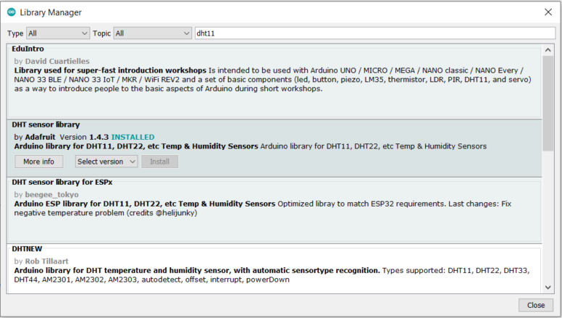
ArduinoJSON Library
Install Arduino Libraries
PubSubClient Library
DHT11 Sensor Library

Slide 8
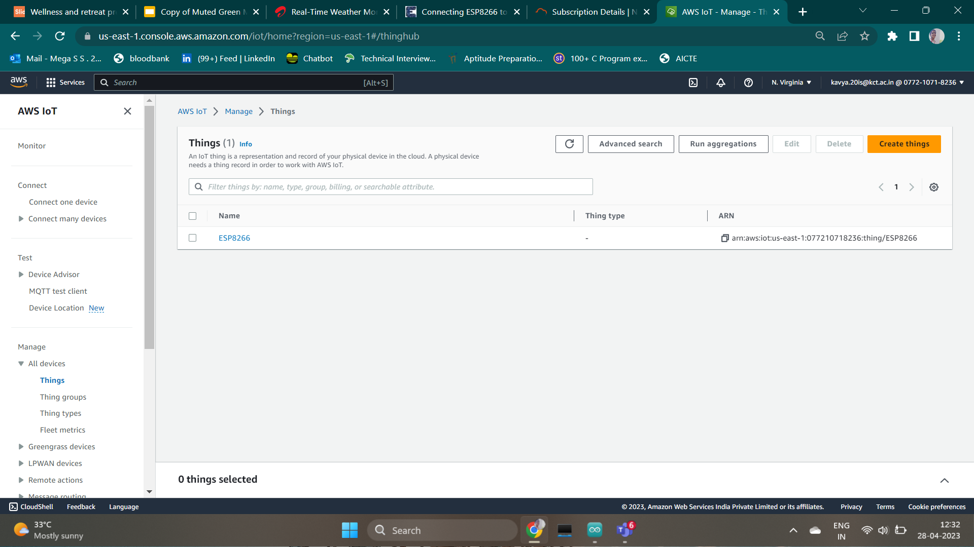
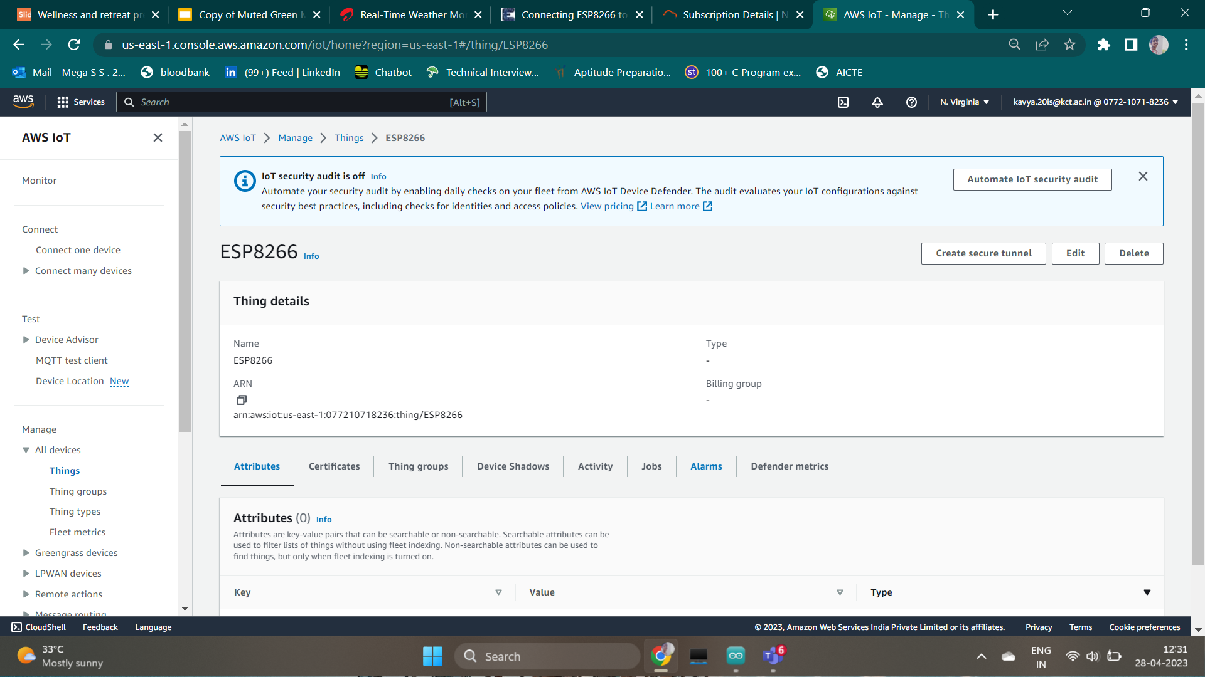
Create
A Thing

Slide 9
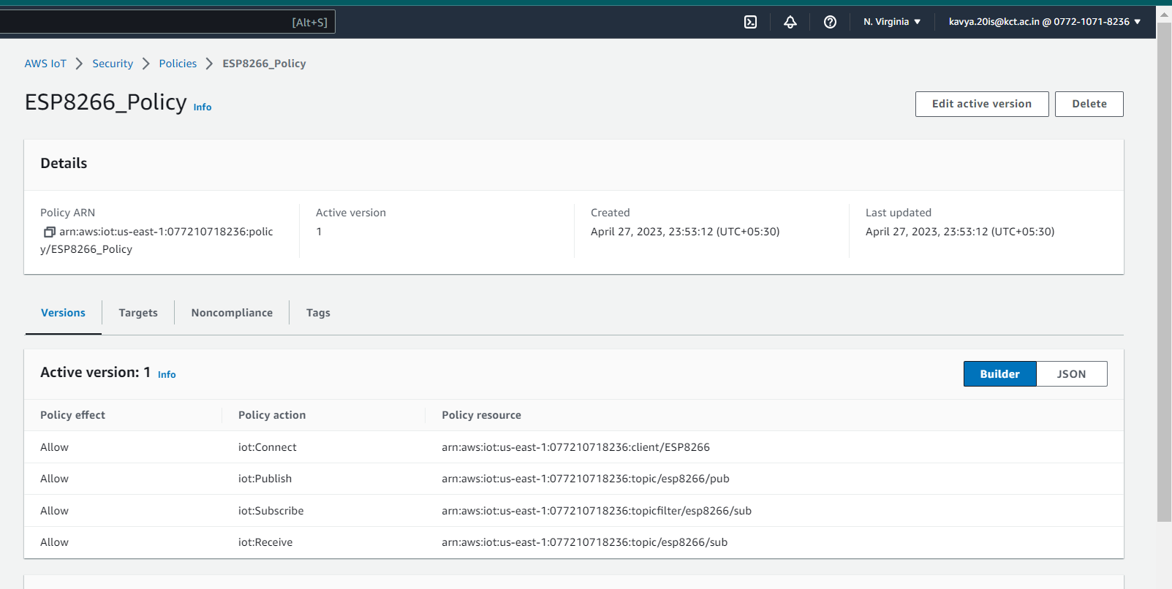
Attach Policy

Slide 10
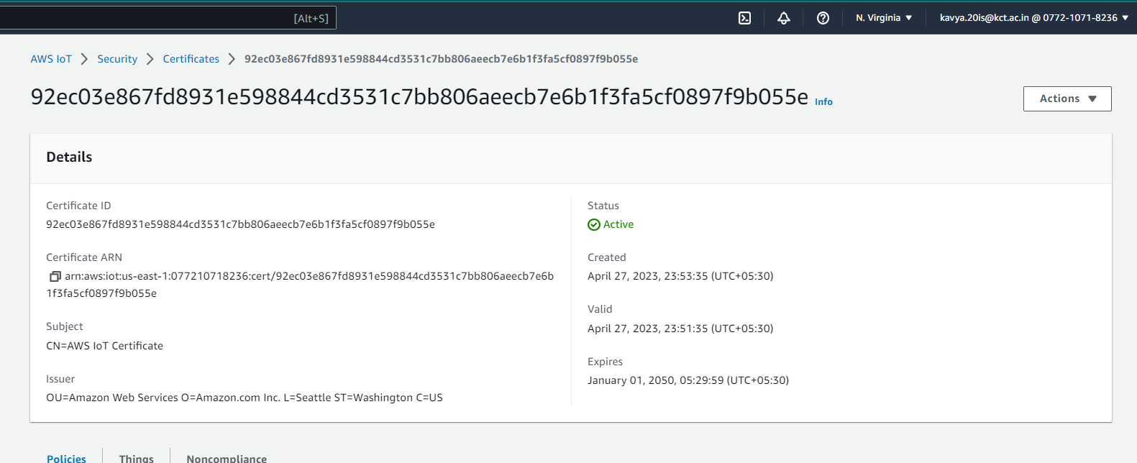
Generate Certificate

Slide 11
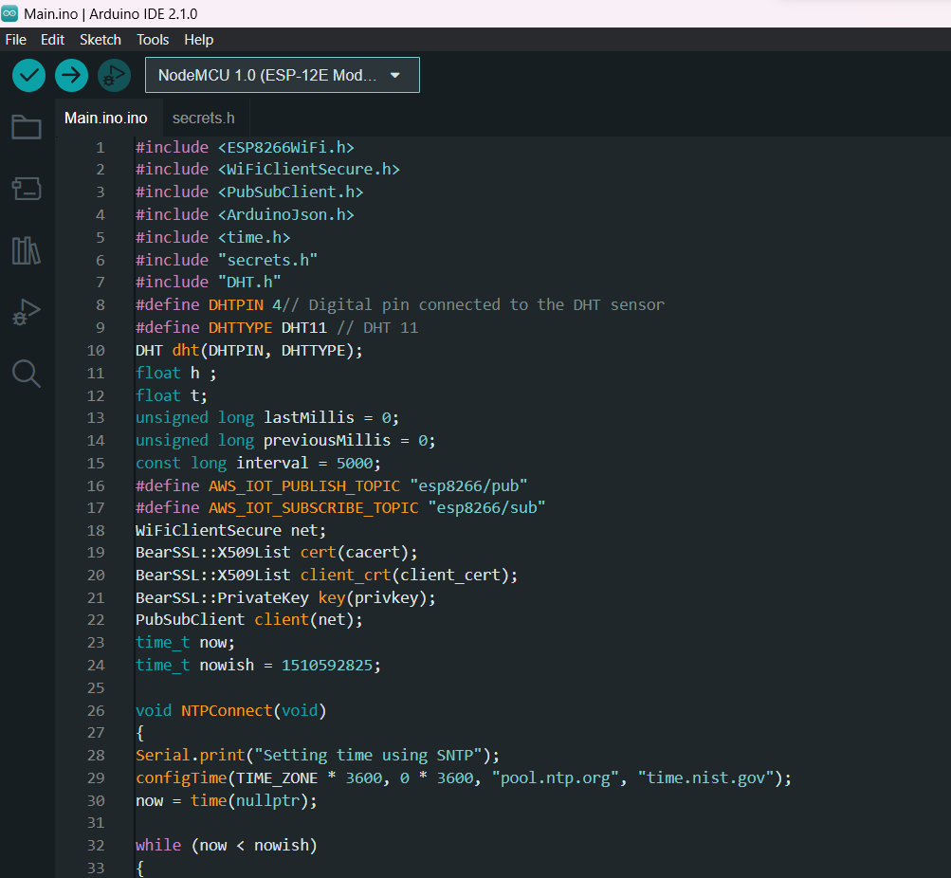
Arduino Code

Slide 12
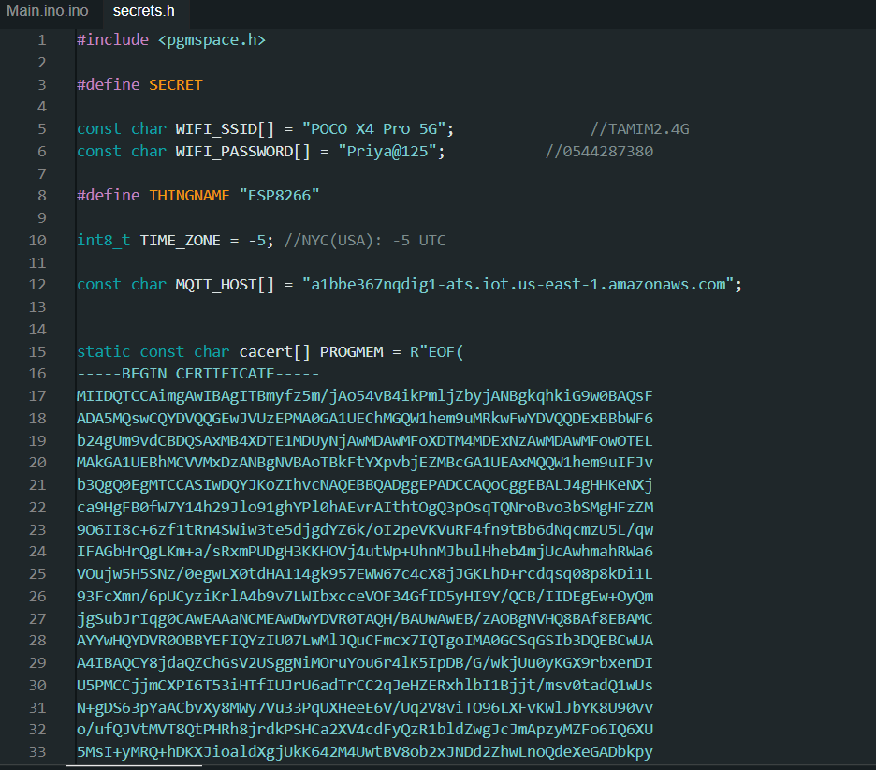
Arduino Code

Slide 13
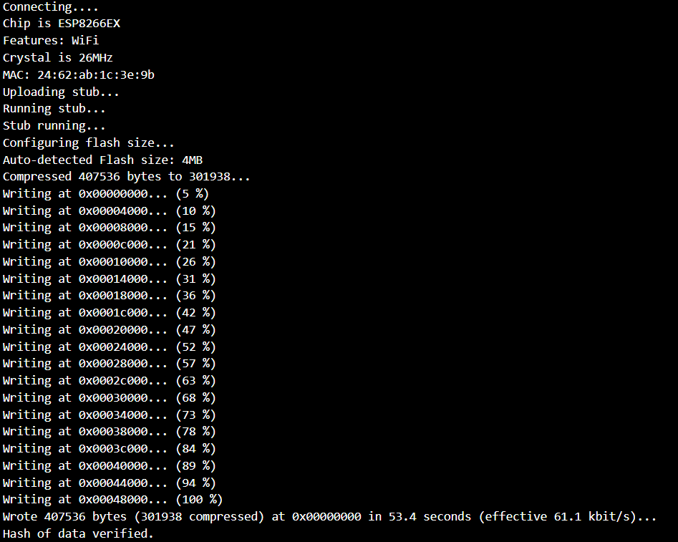
Output

Slide 14
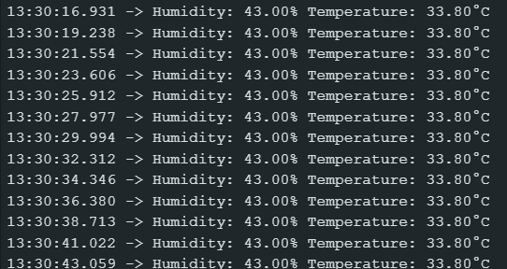
Serial
Monitor

Slide 15
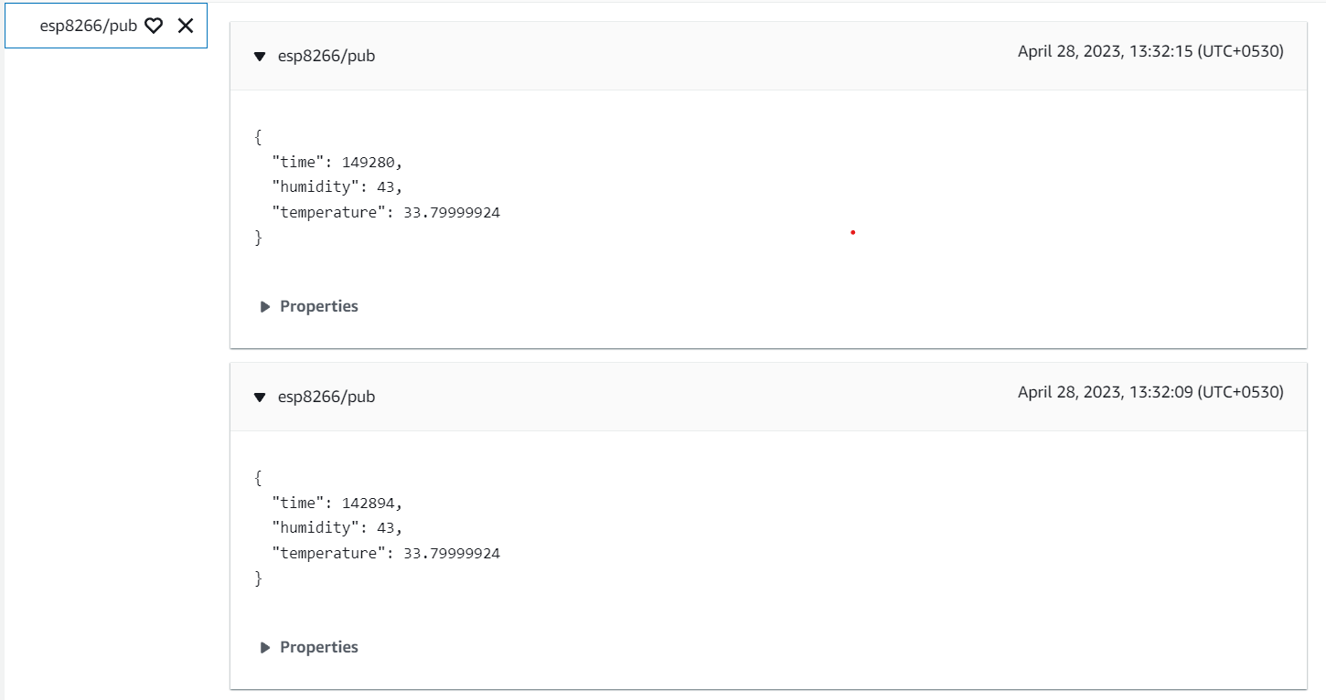
Subscribe

Slide 16
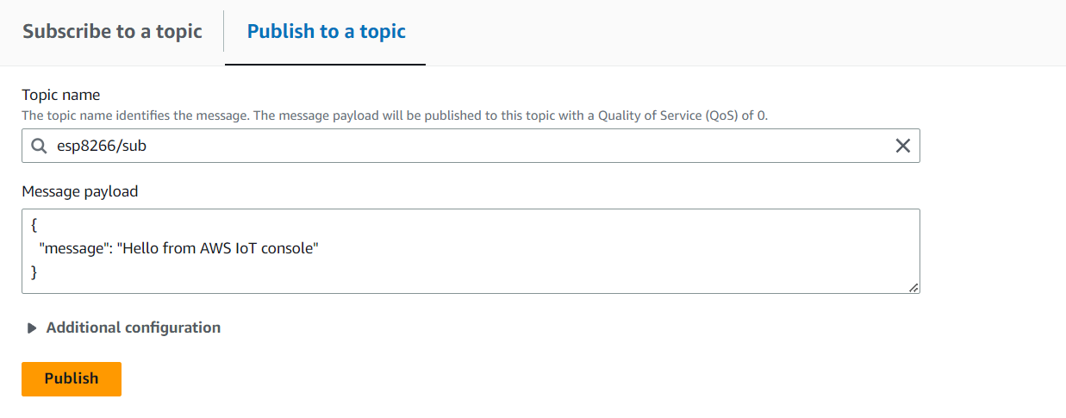
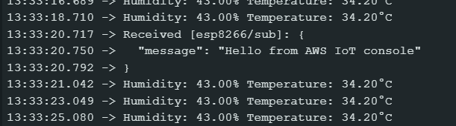
Publish

Slide 17
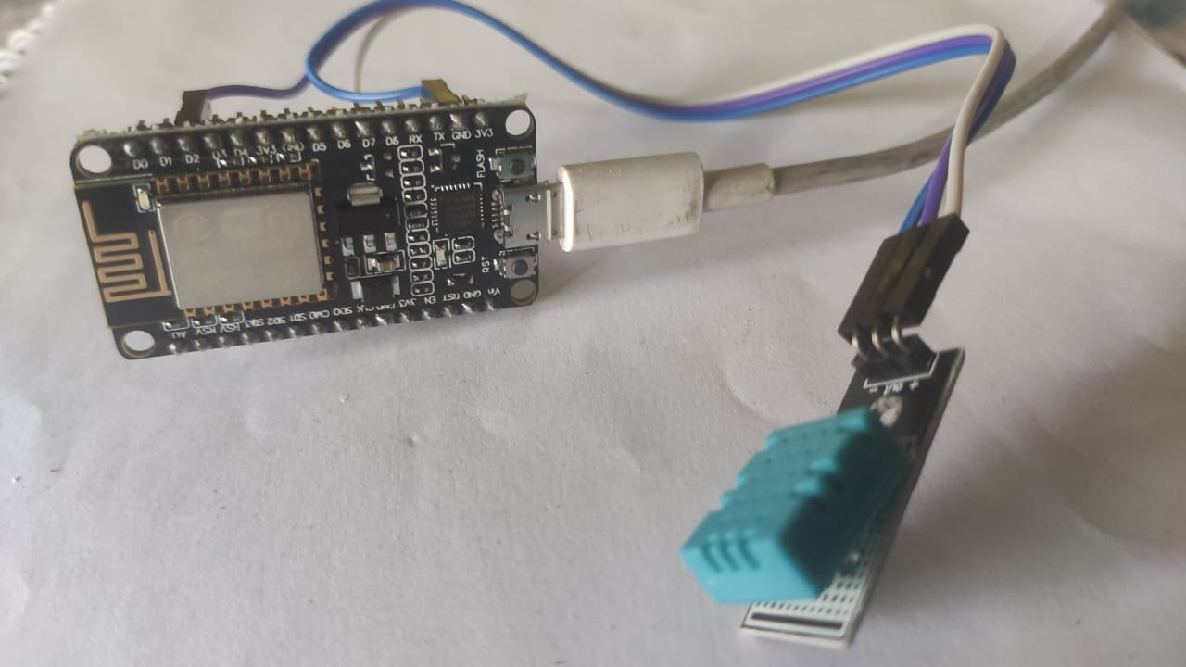
Circuit Connection

Slide 18
Thank You

